Slide 1
TASK-2
Predicting customer buying behavior

Slide 2
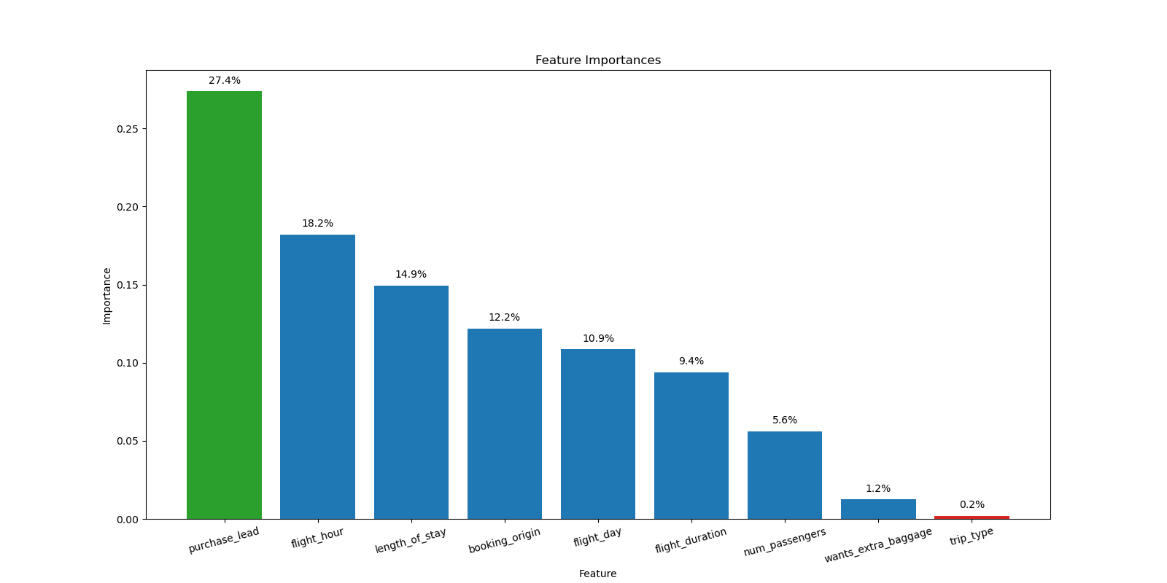

Slide 3
